Slide 1

Project 2
Iteration 1, 2, 3, 4 and 5

Slide 2
Rabindra Gurung(30335729)
Nisha Prasai(30336119)
Pragyan Karkee(30356375)
Dependra Thapa(30335012)
Team member

Slide 3
Introduction – project overview
The website is for all international students as well as for IIBIT students.
Assist all international students for finding the rooms, job, social activities and local suburbs, events etc.
Help the students to make good relationships with others.
Maintain various group communications and also communication with admin using live chat.
Help to organize events, ceremonies, entertainment program for the user.

Slide 4
IIBIT international students and international students.
Students are the important for us as a client.
We as a IIBIT students wanted to help other under going IIBIT students with their daily personal activities to avoid facing difficulties.
Clients will be easily able to use and login to our website.
Client details

Slide 5
Assistant Project Manager (Rabindra)
Project Manager(Nisha )
Lead Developer
( Pragyan)
Designer (Dipendra)
Tester/ Debugger(Pragyan)
Lead Analyst (Nisha)
Roles and responsibilities

Slide 6
Project specific – Domain specific and technical aspects
For creating website GIVEN software will be using:
1. Programming Languages
Bootstrap
CSS
HTML
PHP
2. Database
My SQL
xampp
Javascript

Slide 7
Sprint 1
US4 As a user, I want to have employment services and provide some information so that I can apply for the job which has opened for the job vacancy or staff needed.
US5 As a user, I want to create an account in this website so that I can get some updated information.
US6 As a user, I want to reset the password in the website.
US14 As a user, I want to rate the website so that students could know how good the website is.
US15 As a user, I want to provide the feedback section so that users can share their idea or problems so that we can improve in future.
US20 As an admin, I want to create a marketplace so that the students can sell their cars, books and furniture’s in low rate.
US 23 As an admin, I want to create a chat board so that they can ask everything they want through the chat board and chat where board replies automatically which will help to ask anytime.

Slide 8
Sprint 2
US7 As a user, I want to update/post my experience so that I can express my idea staying in abroad.
US8 As a user, I want to communicate with other students so that I can make some new friends.
US16 As a user, I want to share or upload a picture in the website so that people can know me.
US19 As an admin, I want to share the information about the restaurants, cafe, bars and function centers so that students can spend some time, eat food and have some funs with their friends or relatives.
US21 As an admin, I want to provide best industries and company internship program including videos so that user can grab dates easily.

Slide 9
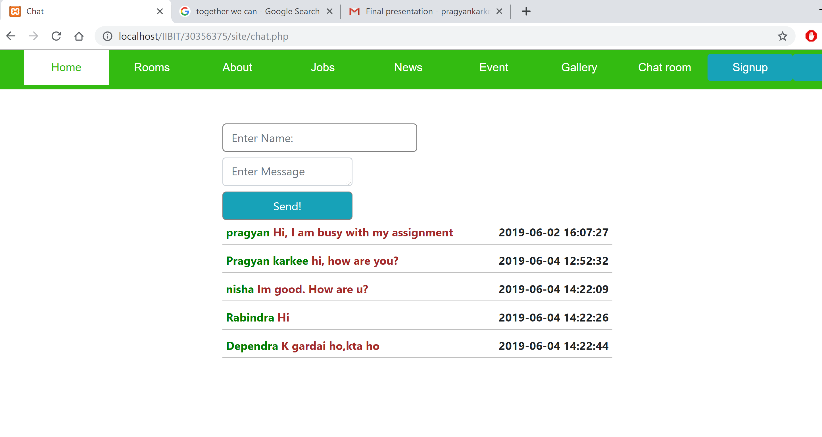
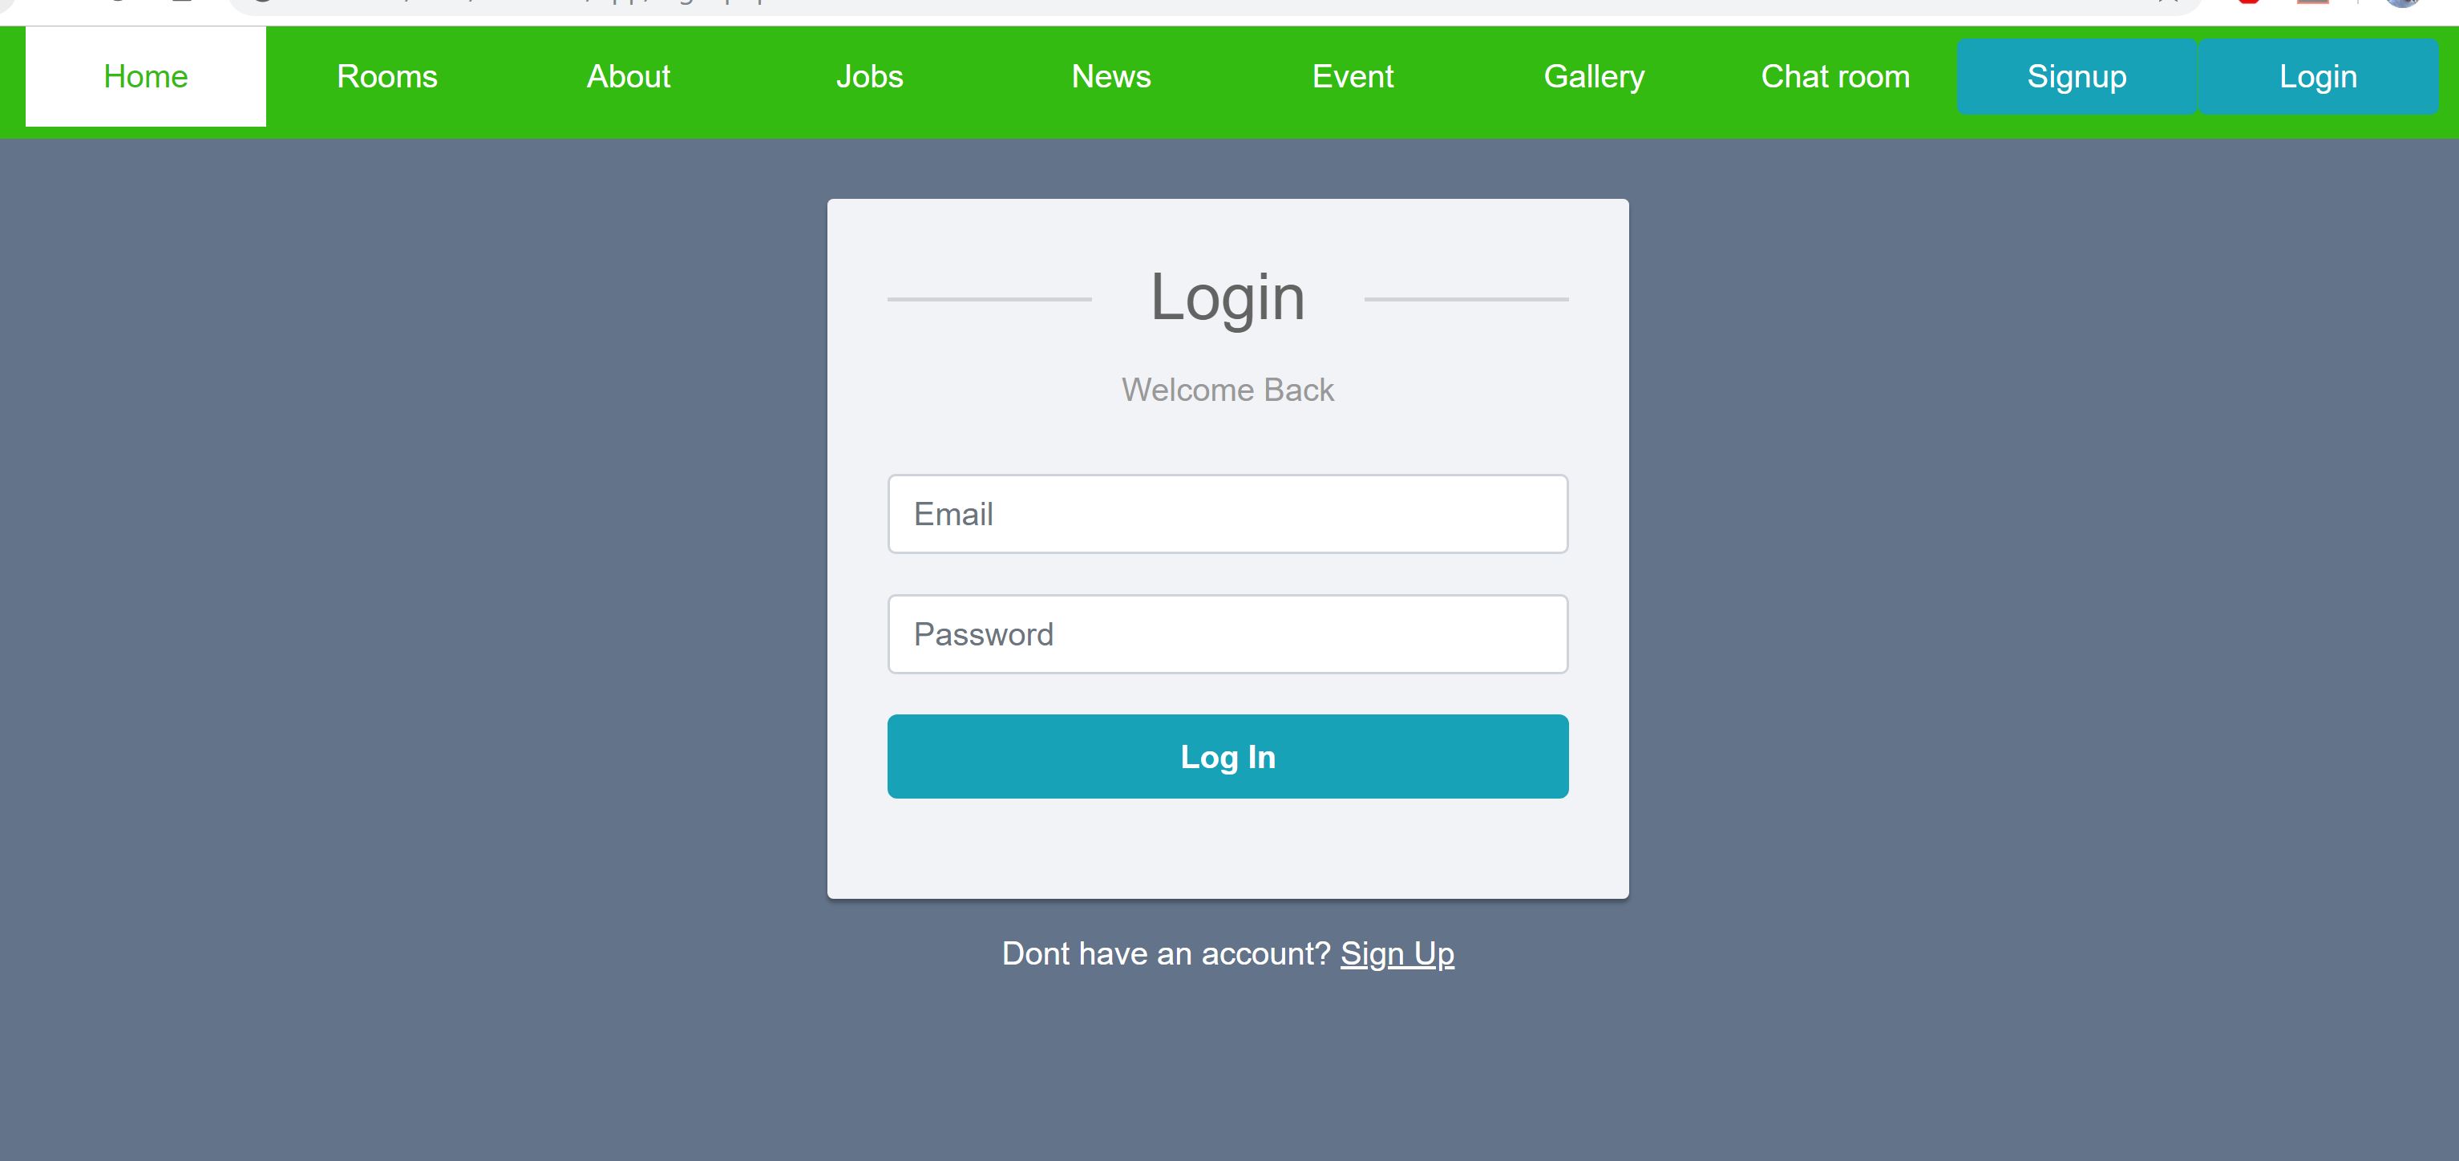
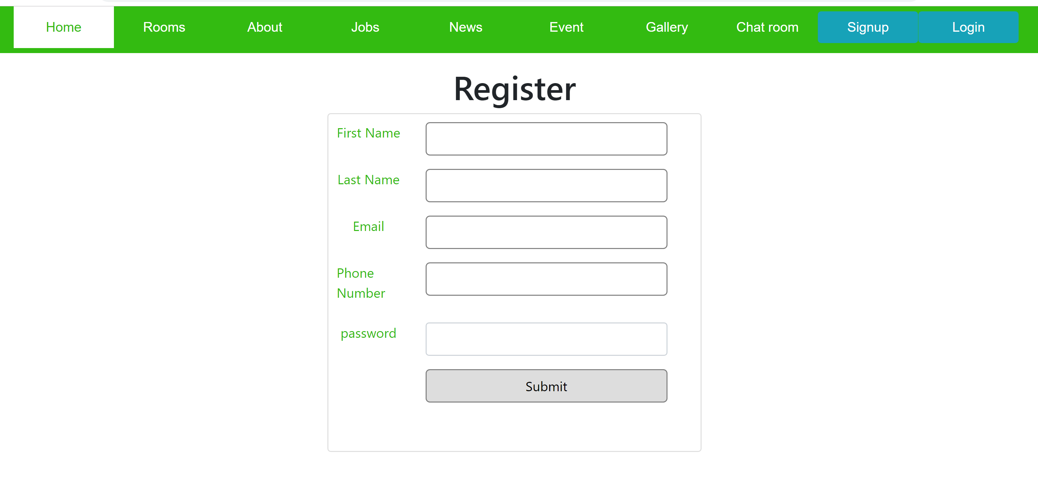
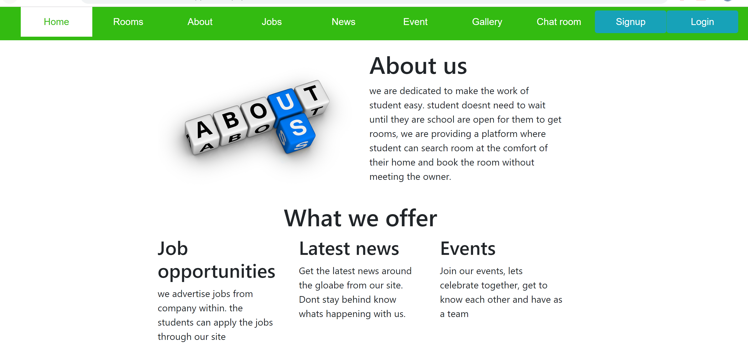
Website Demonstration – Sprint 1&2

Slide 10
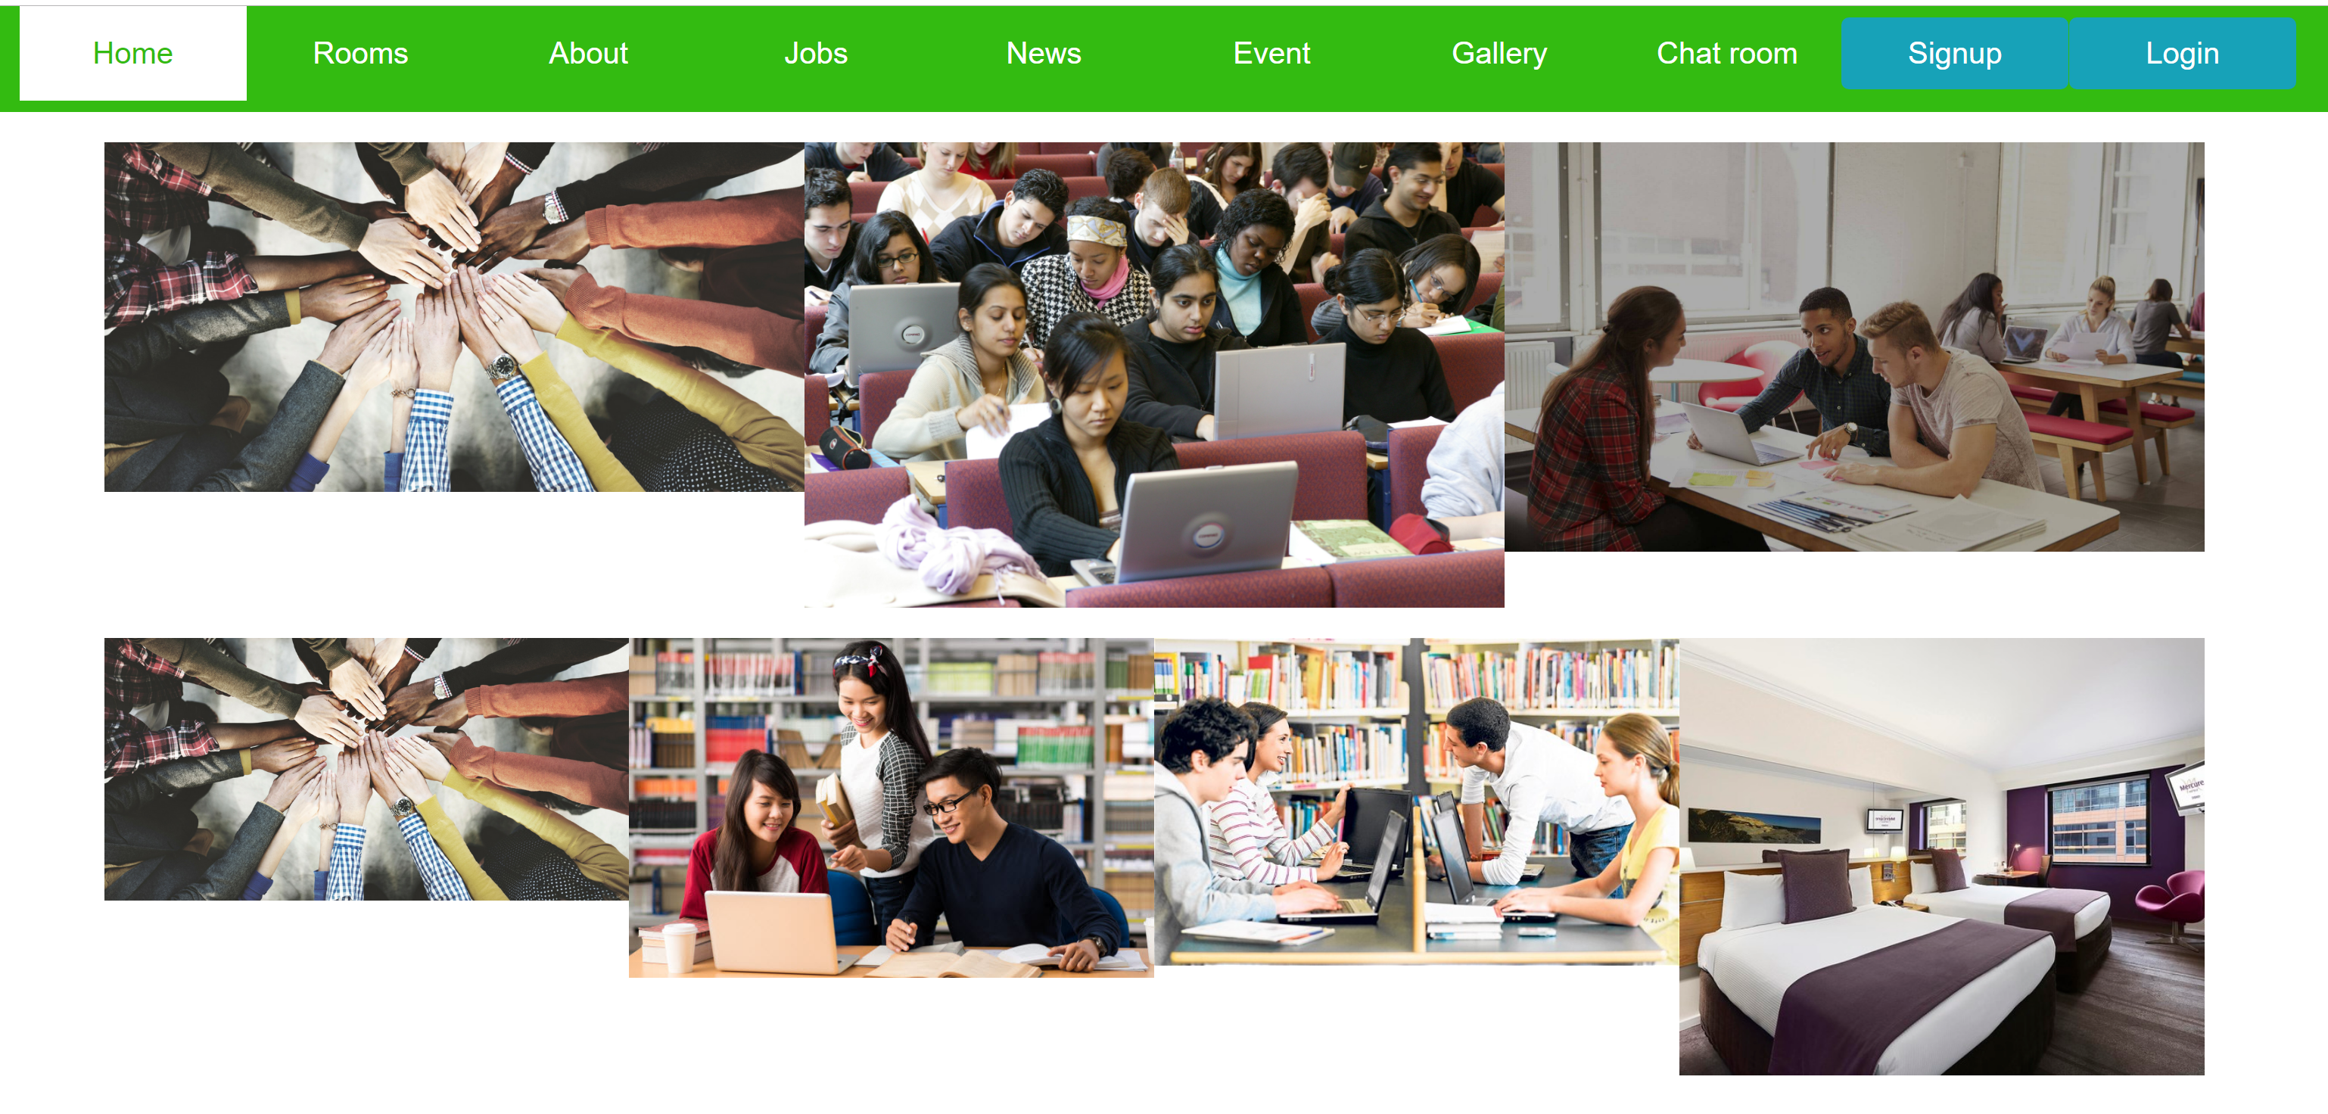
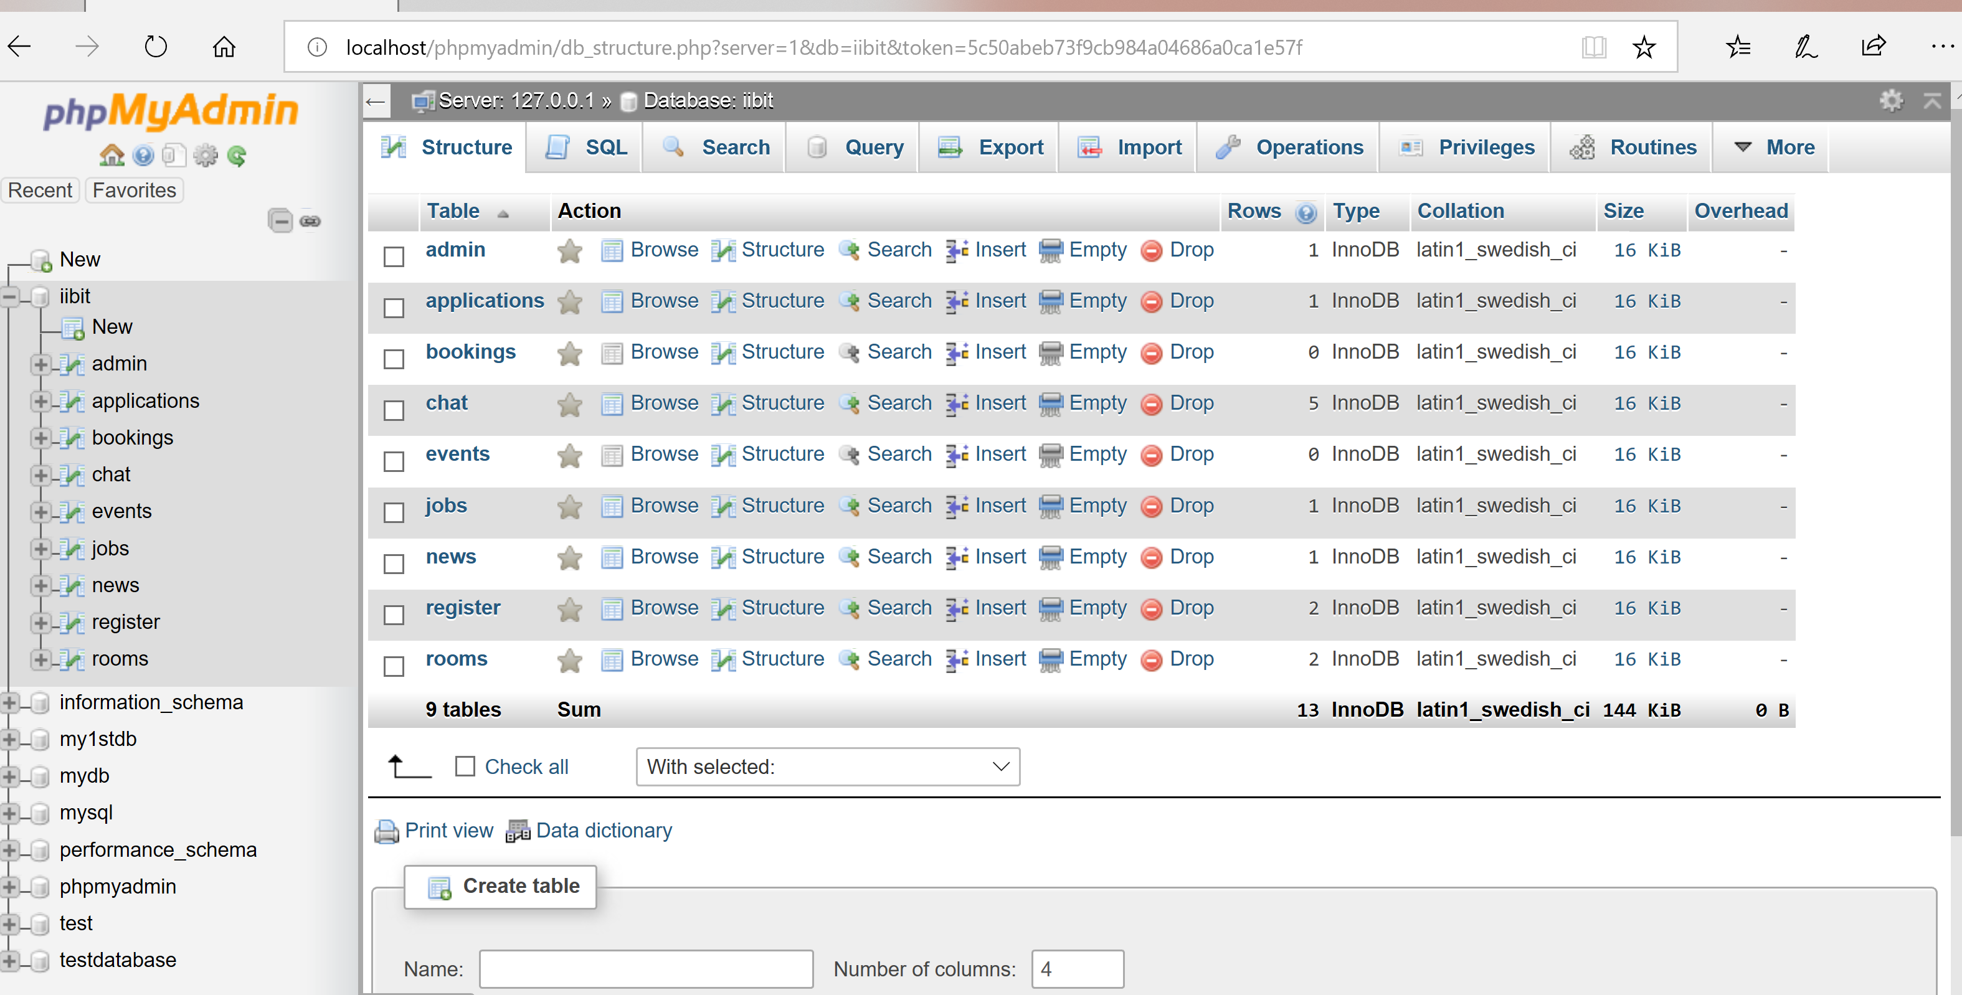
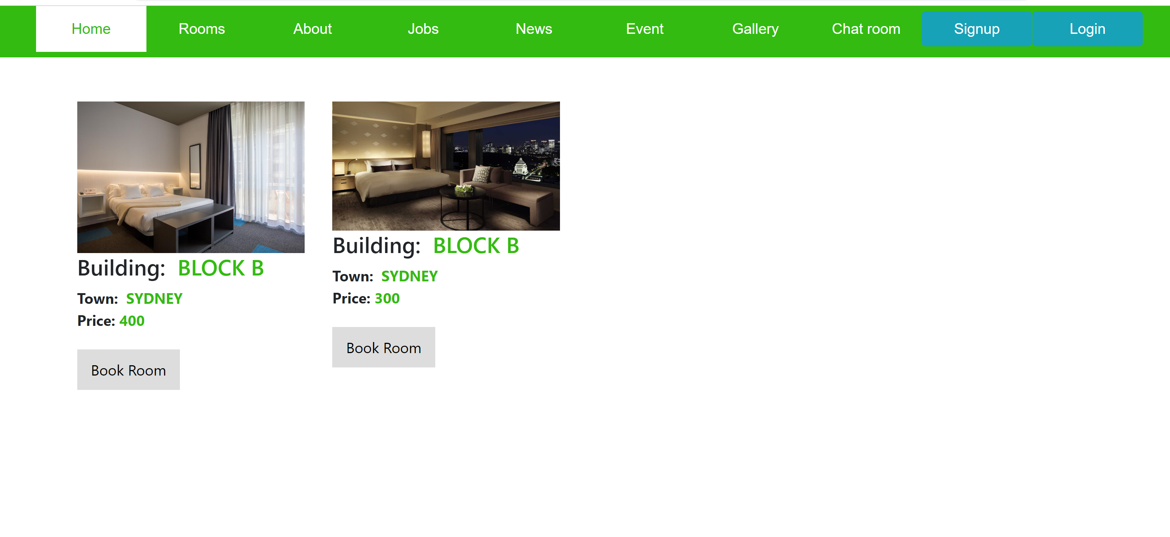

Slide 11
Sprint 3
US1 As a user, I want renting or sharing rooms near stations or bus stops so that I can have affordable living and nearby suburbs.
US2 As a user, I want an information about of cost of living and budgeting so that I can spend less and save little bit of money for my expenses/fees.
US3 As a user, I want to have a good healthcare and insurance information and details/ nearby addresses so that whenever I become sick or have any serious issues with health I can immediately go for treatment.
US9 As a user, I want to receive some information about creating bank account, tax file number for the new starters.
US10 As a user, I want to be a part of social activities organized nearby so that I can be engaged with international cultural activities and have some entertainment with different cultural groups.

Slide 12
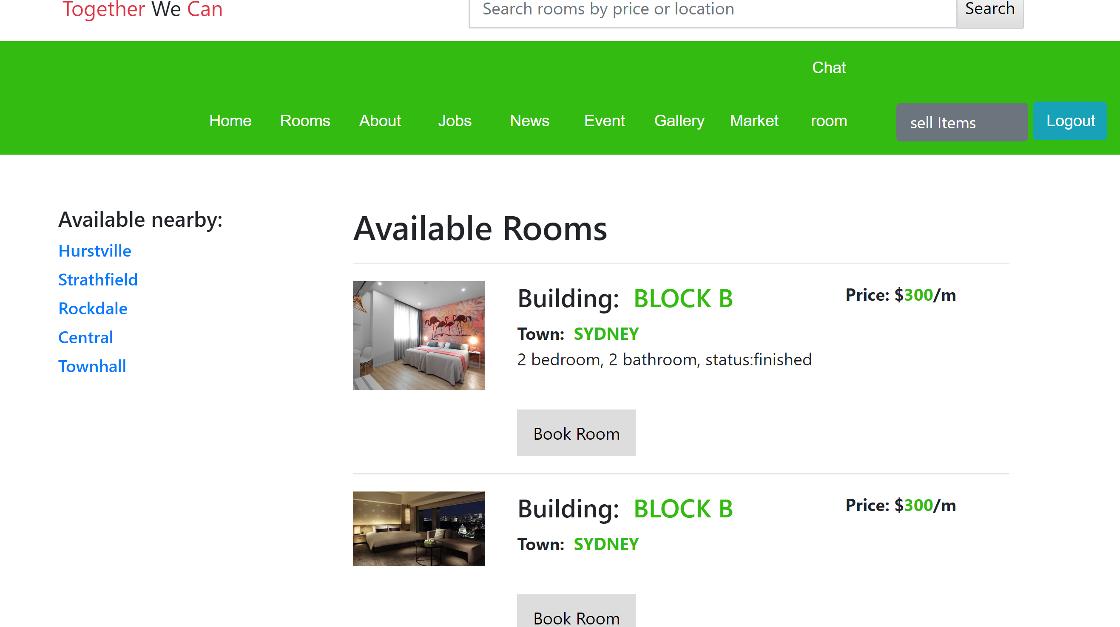
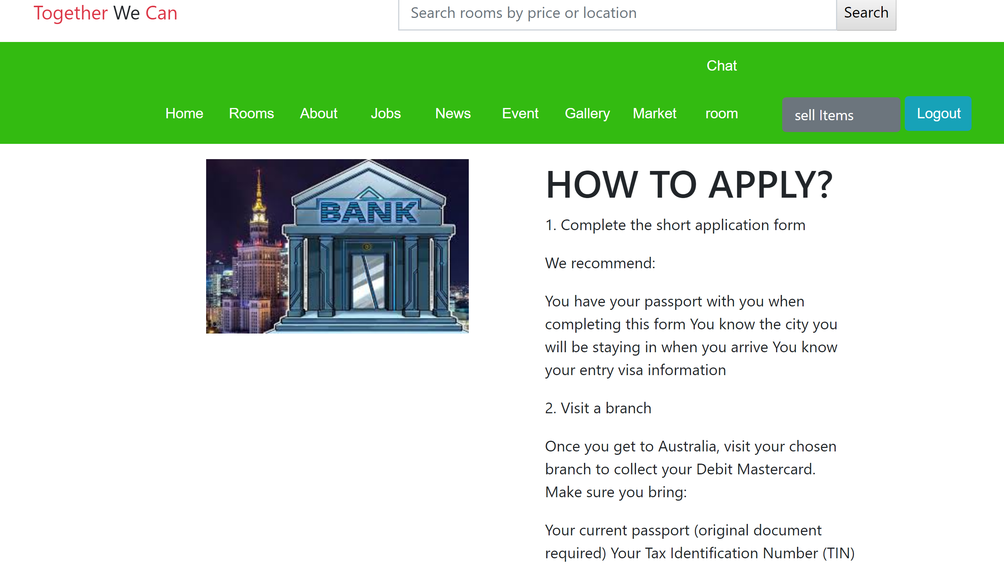
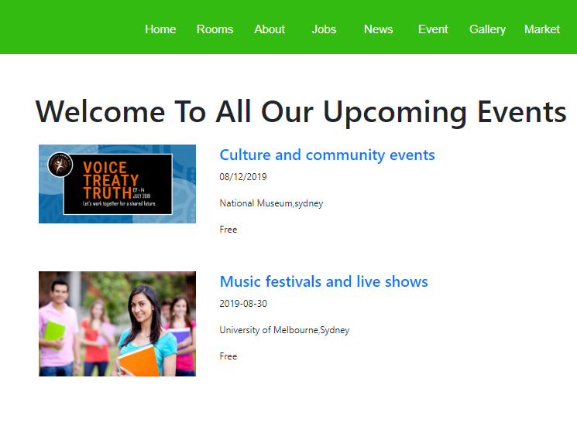
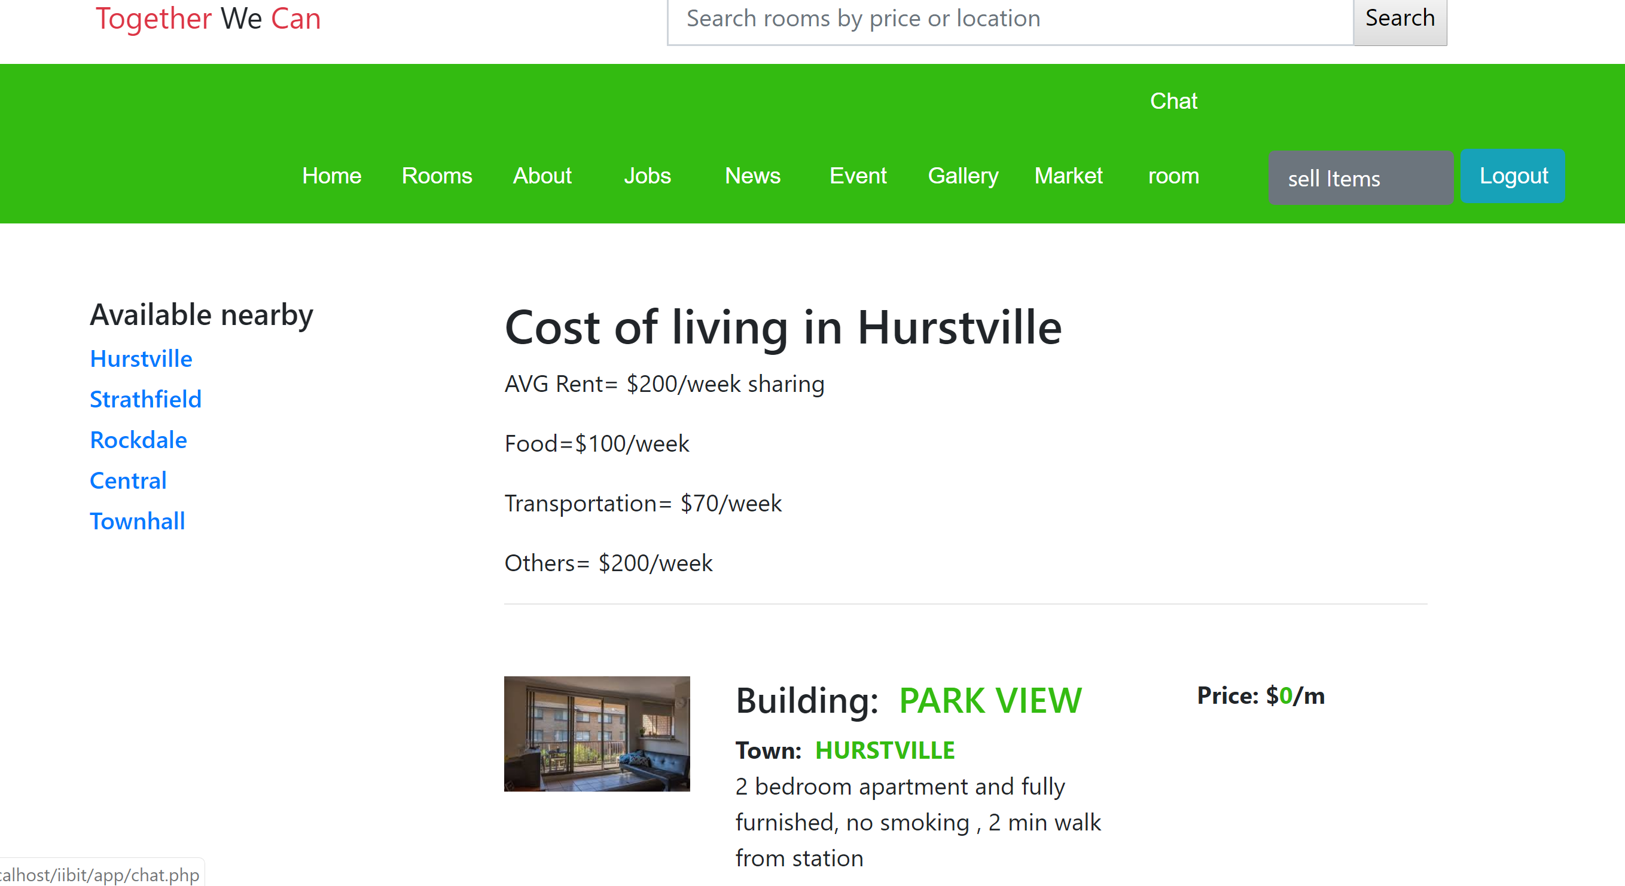
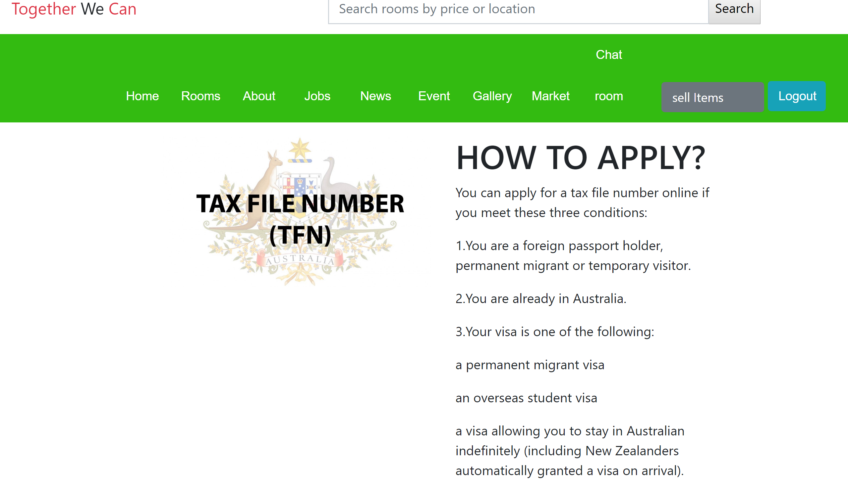
Sprint 3 website review

Slide 13
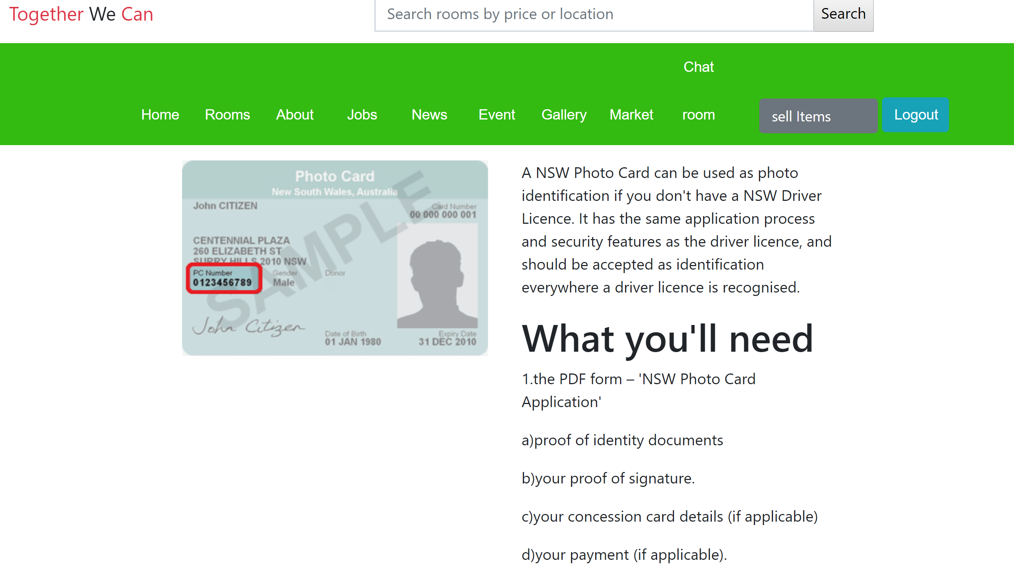
Sprint 4
US17 As a user, I want an information about to apply for photo ID, so that I could take anywhere instead of my passport.

Slide 14
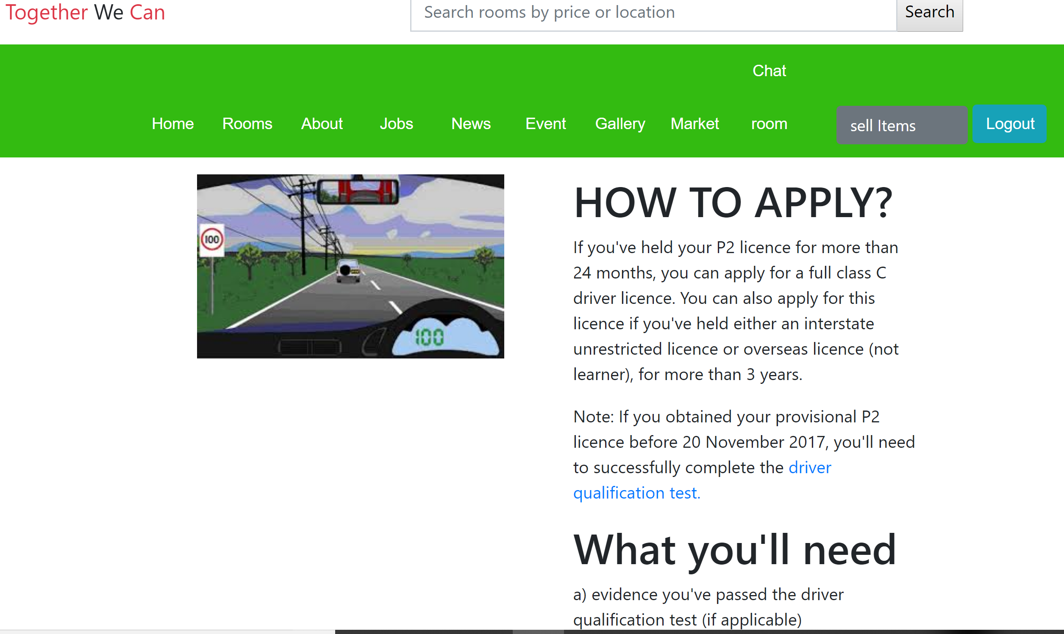
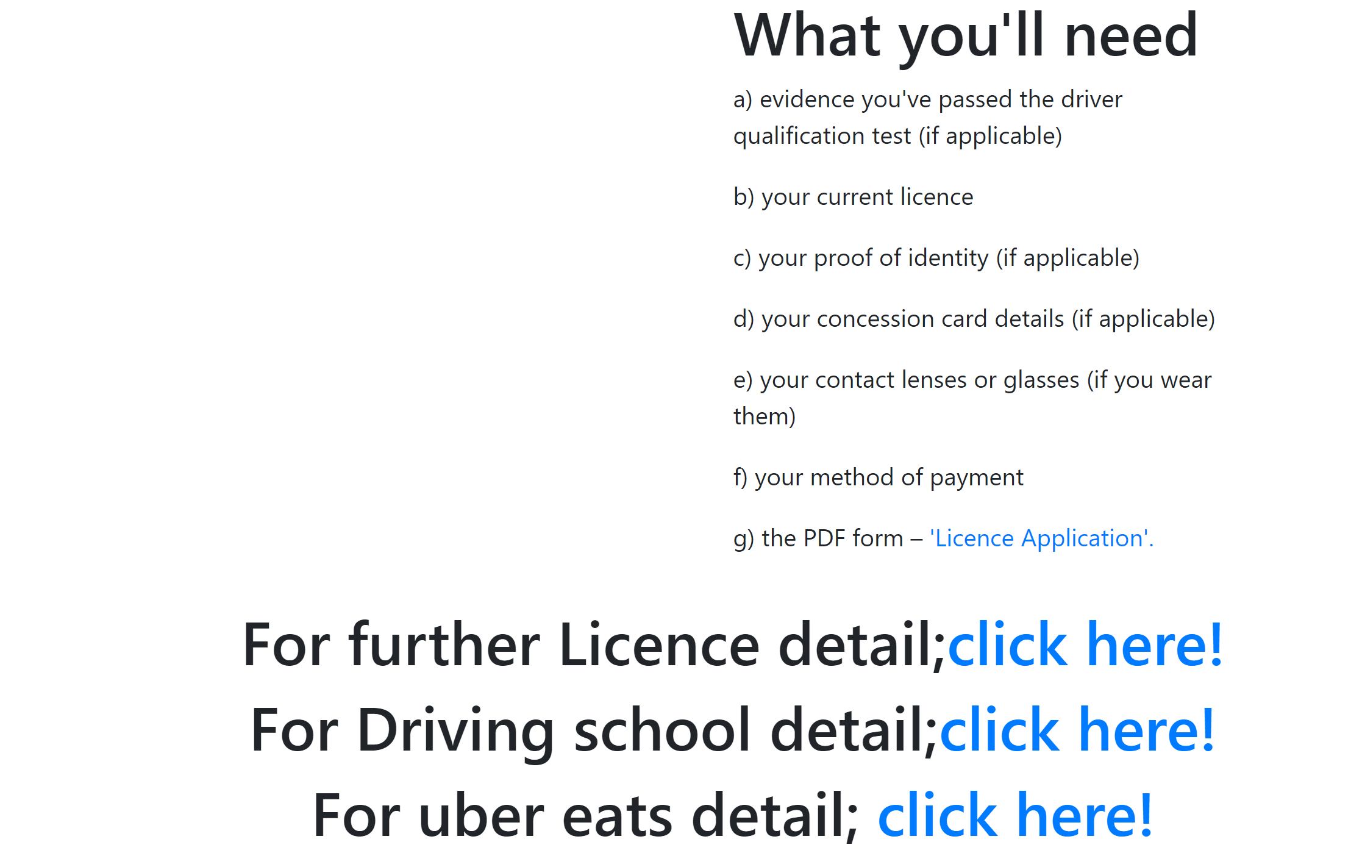
US18 As a user, I want to get ideas about getting driving license so that I could do Uber eats and Uber for my extra saving.

Slide 15
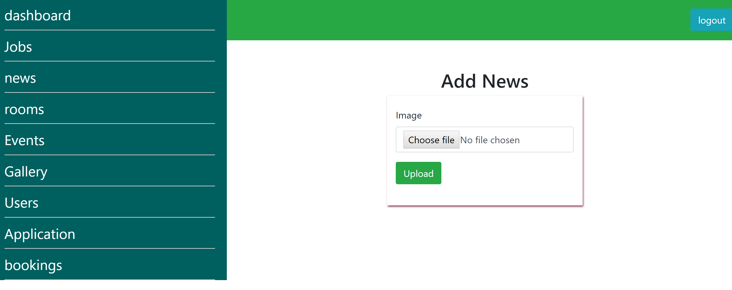
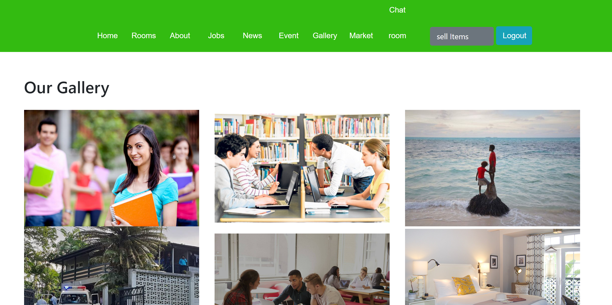
US22 As an admin, I want to regularly update picture in gallery.

Slide 16
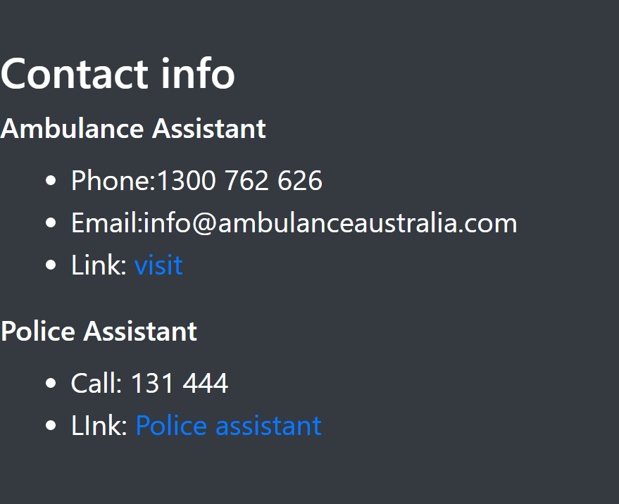
US26 As a user, I want to see contact details.

Slide 17
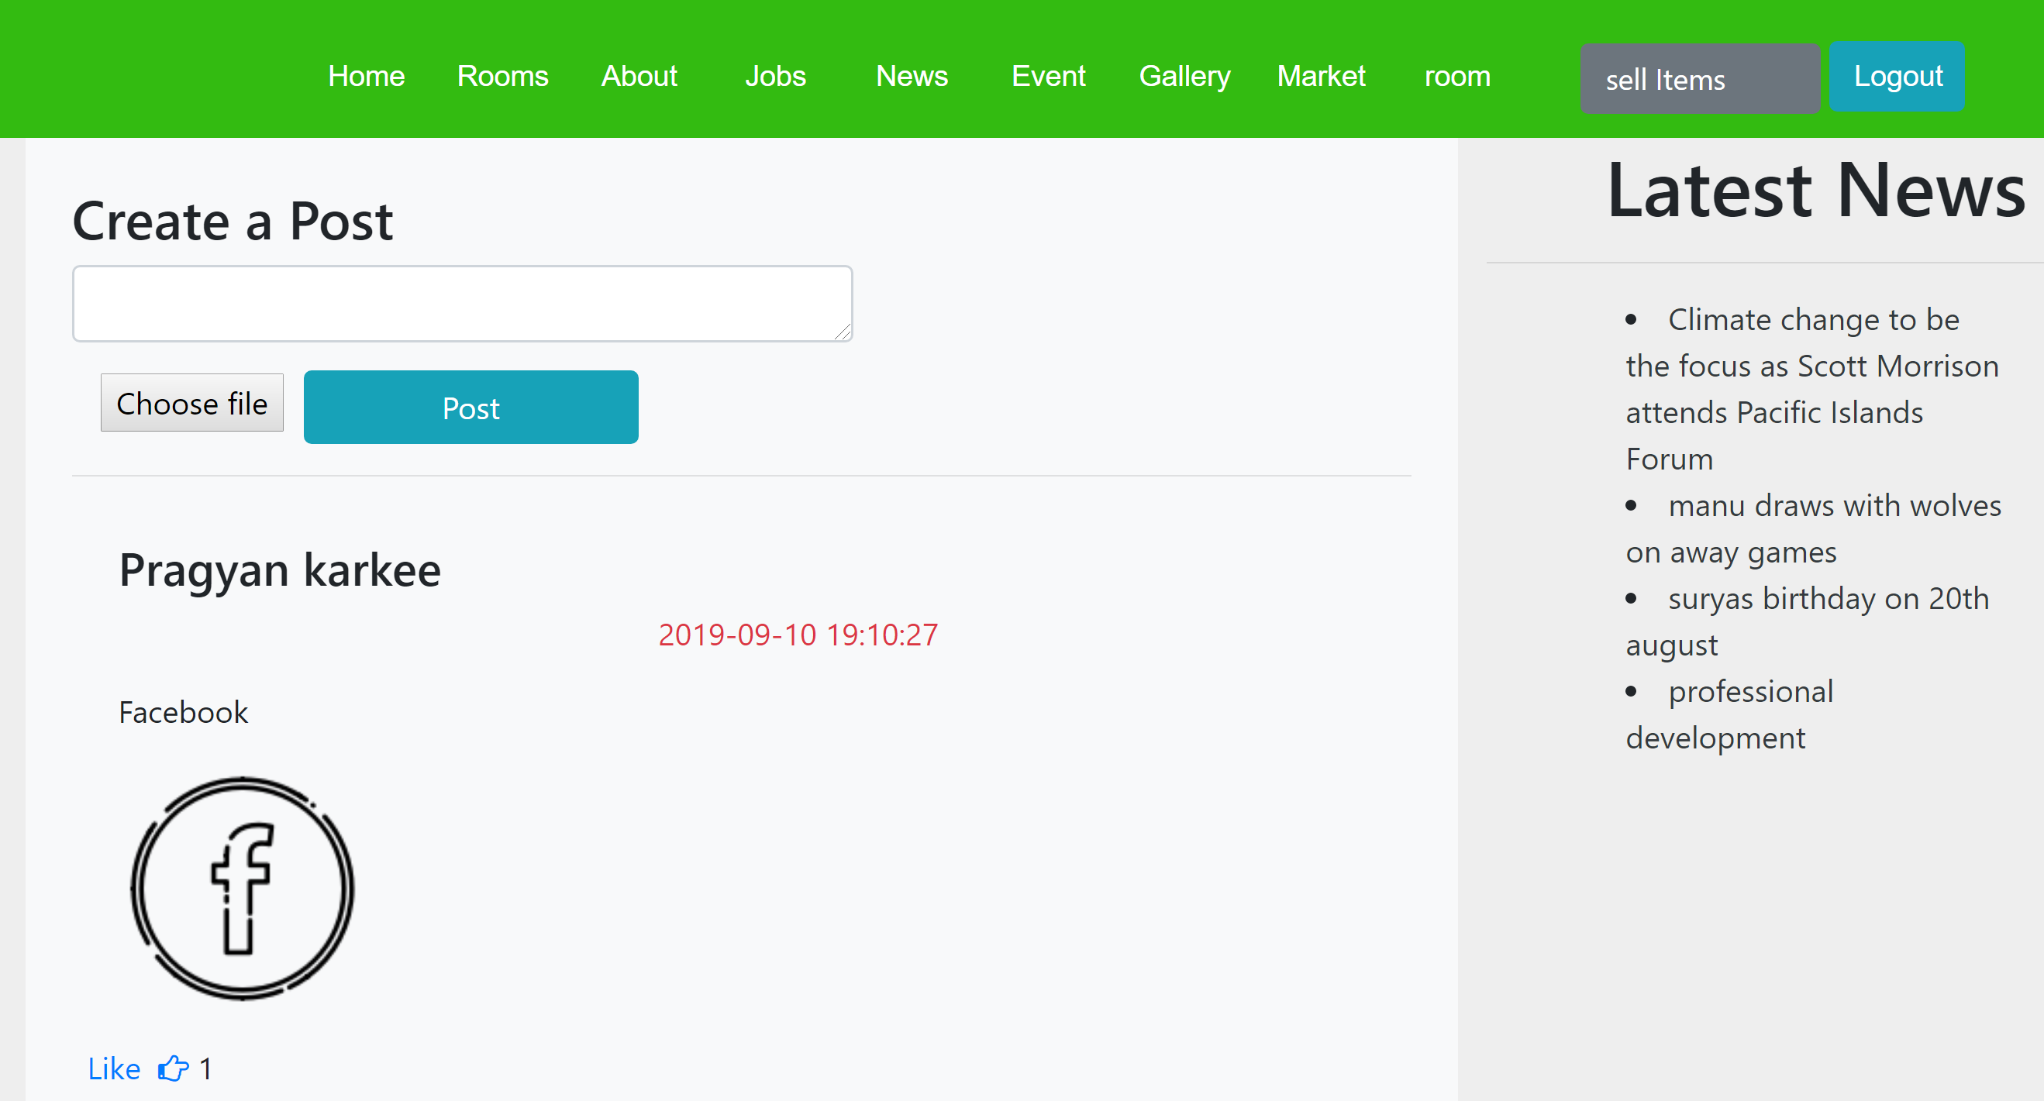
US27 As a user, I want to post my everyday status with picture and view others posts and like.

Slide 18
SPRINT 5
US12 As a user, I want latest news and upcoming events to appear directly in a homepage screen.
US13 As a user, I should be able to search rooms by price and location directly from search bar in home page.
US 24 As an admin, I should be able to see all website users detail Like email, phone and full name, etc.
US 25 As an admin, I should be able to view all job applicant CV and give them necessary advice and help them in their carrier.
US 28 As an admin, I should be able to see all bookings of all rooms and details of the tenant.

Slide 19
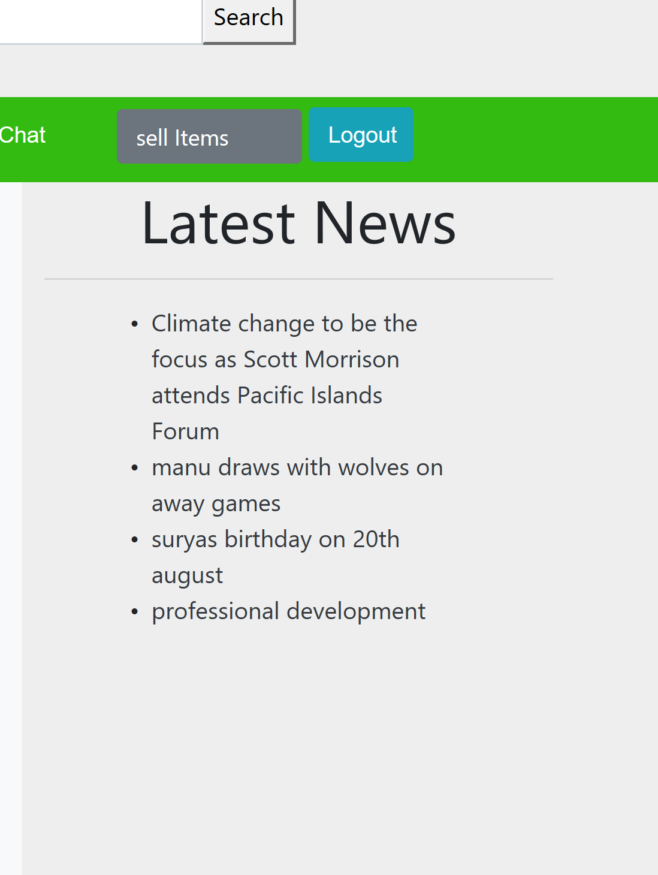

US12 As a user, I want latest news and upcoming events to appear directly in a homepage screen.

Slide 20
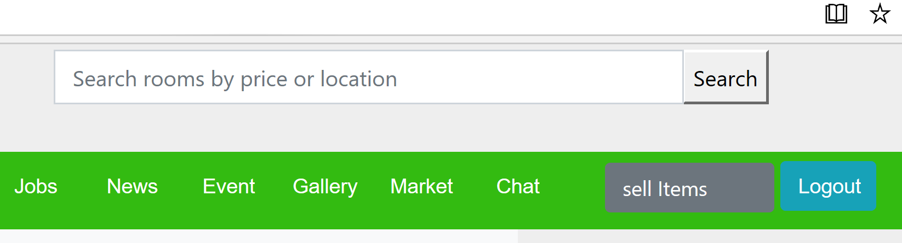
US13 As a user, I should be able to search rooms by price and location directly from search bar in home page.

Slide 21
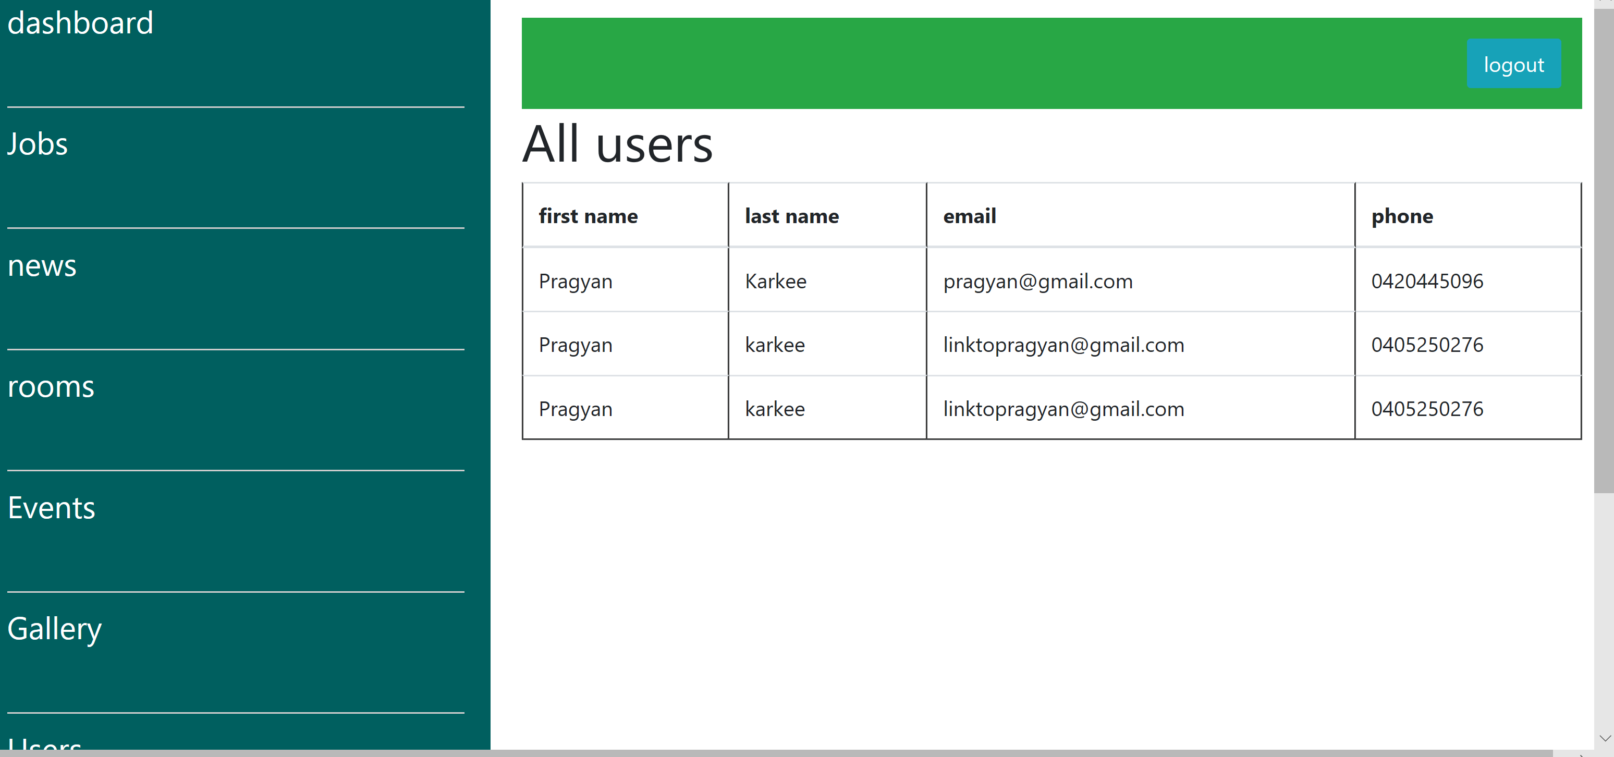
US 24 As an admin, I should be able to see all website users detail Like email, phone and full name, etc.

Slide 22
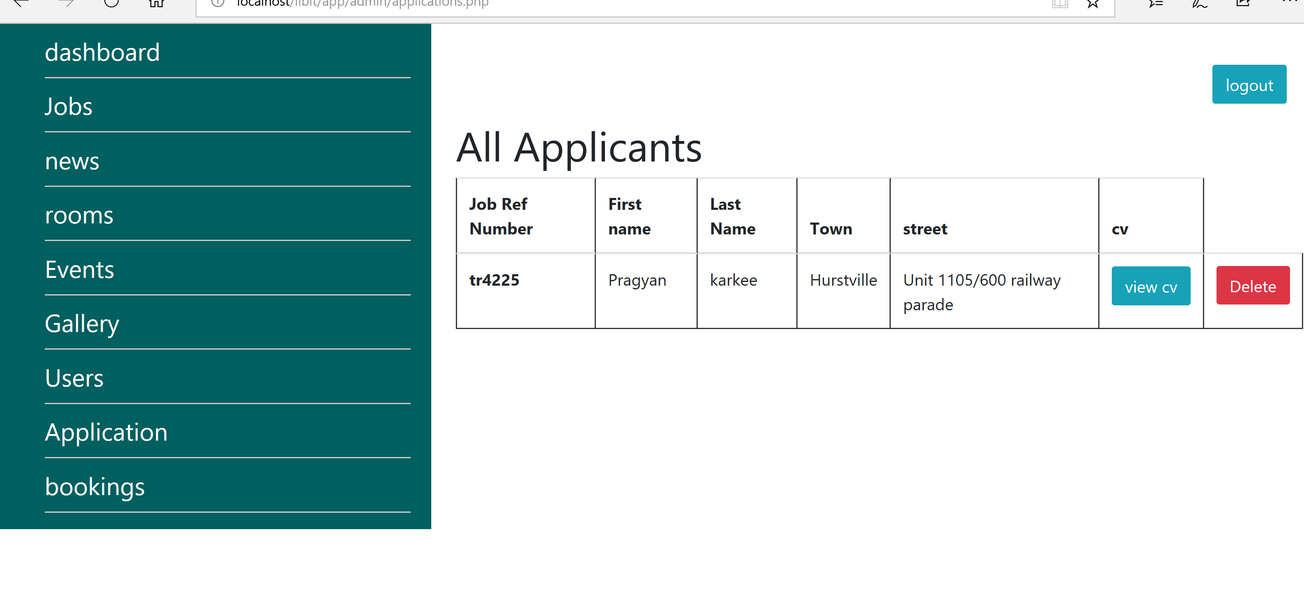
US 25 As an admin, I should be able to view all job applicant CV and give them necessary advice and help them in their carrier.

Slide 23
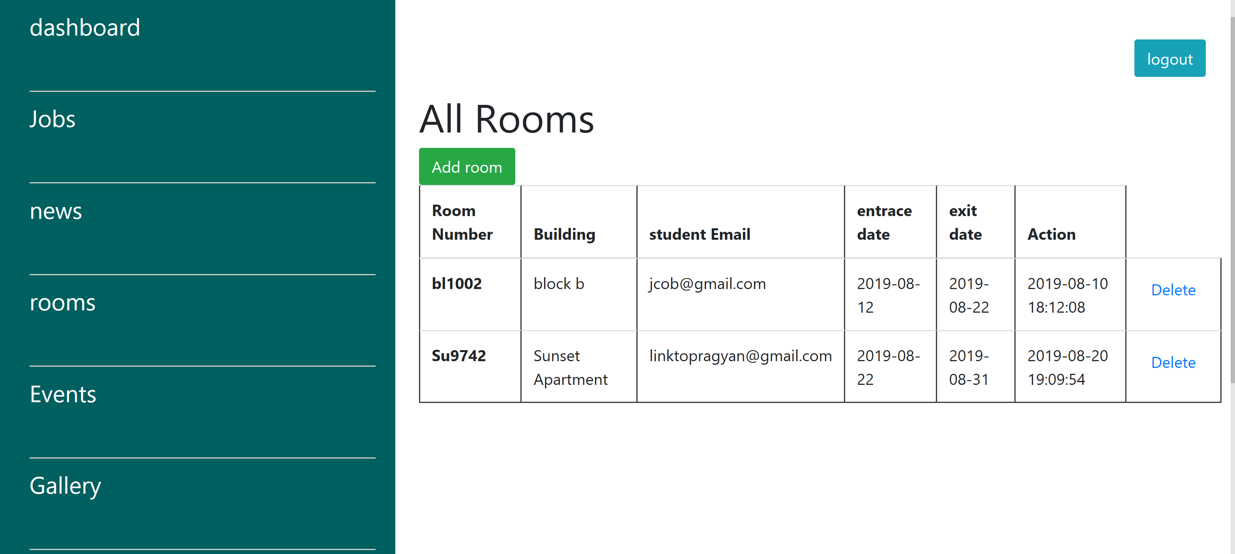
US 28 As an admin, I should be able to see all bookings of all rooms and details of the tenant.

Slide 24
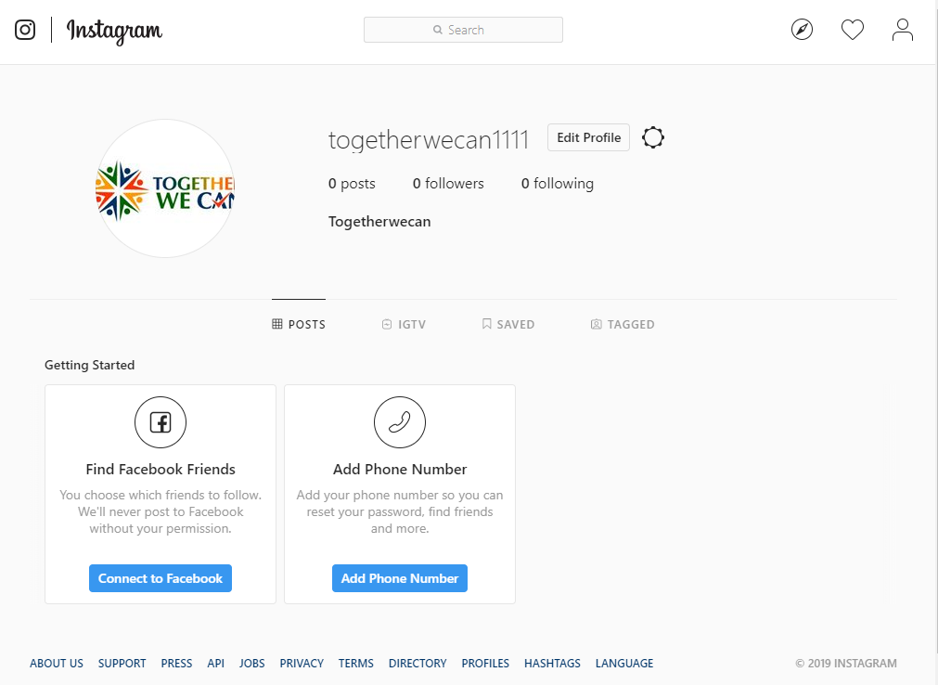
Website review

Slide 25
Critical reflection
What went well?
Demonstration of the user went well.
Users were pleased with the design.
All members of the team do their job well.
Our project assignment was completed by the team on time as expected.
The development team discovered excellent and accountable participation in project manual job.
What is not in our control?
Software compatibility is not known to the development team.
Errors occurred during the use of codes.
Absence in class until the setup is complete.

Slide 26
Conclusion
In our prior semester, this is the overall sprints done from 1 to 5 and it went pretty well as expected.
We team work works well and we are successful to make our website at last.
As we have finished all sprint in this semester and also we hope for good feedbacks for our website.

Slide 27
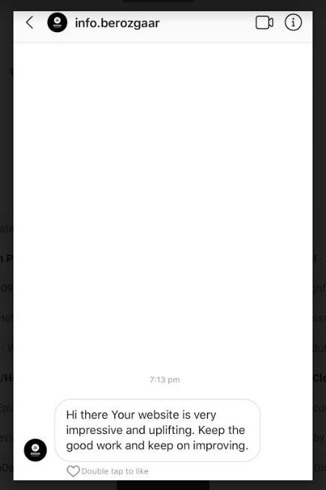
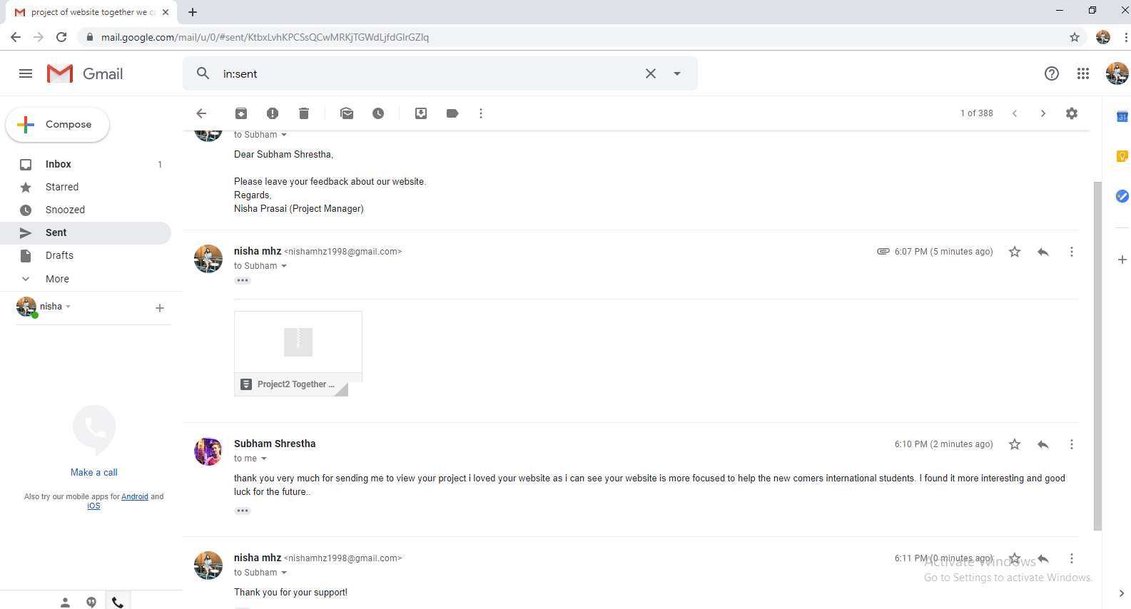
Client feedback

Slide 28
Thank you!!
Any questions?

